Slide 1
CHE352 PROJECT
Group 4
INSTRUCTOR : Prof. Vishal Agarwal
Members:
Ishika Singh(160302)
Sirjan Jain(160693)
Monal Goel(160415)
Shivam Barodiya(160652)
Varanasi Nitesh(160774)
Krishan Kumar Tetarwal(160338)
Naman Swarnkar (150434)
Abhishek Mehta (160034)

Slide 2
Problem Statement
To simulate a multicomponent distillation column using Naphtali and Sandholm Newton-Raphson algorithm incorporating vapor-phase non-idealities in Matlab.
Compute composition on each tray (including bottom and distillate).
Plot the temperature profile inside the distillation column.
To check the results obtained from Matlab by performing rigorous simulation in ASPEN.
Given :
Methanol =15 kmol/h, Acetone = 40 kmol/h, Methyl Acetate = 5 kmol/h, Benzene = 20 kmol/h, Chloroform = 20 kmol/h.
Column pressure = 1 atm, Feed plate location = 6, Number of plates inside column = 17,Thermal condition of Feed =Liquid at 330 K, Type of Condenser= Total,Reflux ratio= 9.5, Bottom flow rate = 62 kmol/h, Type of Reboiler = Partial
Activity coefficients for liquid phase calculated by Wilson’s equation.
Fugacity coefficients for vapour phase obtained from Redlich-Kwong equation of state.
Murphree tray efficiency = 0.85 and Departure functions for vapour phase enthalpies

Slide 3
Degree of Freedom Analysis
Number of components = c = 5 (Methanol, Acetone, Methyl Acetate, Benzene, Chloroform)
Number of stages = N = 19 (including condenser and reboiler)
Number of independent variables = 495 = (3*N*c + 11*N + 1)
Murphree Tray efficiency(all stages) = 19 (N) F = 19 (N) Q = 19 (N)
T(all stages) = 19 (N) L = 19 (N) x,y,z = 3*19*5 (3*N*c)
T(incoming feed) = 19 (N) U = 19 (N) No. of Trays(N) = 1
P(all stages) = 19 (N) V = 19 (N)
P(incoming feed) = 19 (N) W = 19 (N)
Number of independent equations = 247 = (2*N*c + 3*N)
Mij = 19*5 (N*c) Eij = 19*5 (N*c) Hj = 19 (N) Sx & Sy = 2*19 (2*N)
Degrees of freedom = Number of independent variables - Number of independent equations = (3*N*c + 11*N + 1) - (2*N*c + 3*N) = (N*c + 8*N + 1)
Values to be mentioned = 248 = (N*c + 8*N + 1)
Murphree Tray efficiency(all stages) = 19 (N) F = 19 (N) zi = 19*5 (N*c)
T(incoming feed) = 19 (N) U = 19 (N) No. of Trays(N) = 1
P(all stages) = 19 (N) W = 19 (N)
P(incoming feed) = 19 (N) Q = 19 (N)
Hence, system is sufficiently defined...

Slide 4
LOGIC - Naphtali Sandholm Formulation
Converting to MEH equation
L_{j}*x_{ij} = l_{ij}
V_{j}*y_{ij} = v_{ij}
F_{j}*z_{ij} = f_{ij}
Murphree Tray Efficiency(n) :- n_{i}k_{i,j}x_{i,j} - y_{i,j} + (1-n_{i}) y_{i,j+1}=0
Substituting assumptions of Naphtali Sandholm in equations, we get :-
Mass Balance :- M_{ij}= f_{ij} + v_{i,j+1} + l_{i,j-1} - l_{ij}(1+s_{j}) - v_{ij}(1+S_{j}) = 0
Equilibrium equations :- E_{ij} = n_{j}*K_{ij}*l_{ij}/L_{i} – v_{ij}/V_{i} + (1-n_{j})v_{i+1,j}/V_{i+1} = 0
Enthalpy Balance :- H_{j} = F_{j}*h^{F}_{j} + V_{j+1}h^{V}_{j+1} + L_{j-1}h^{L}_{j-1} - (1+s_{j})h^{L}_{j}L_{j} - (1+S_{j})^{V}h_{j}V_{j} - Q_{j}= 0
Taking initial guess
Solving Rachford Rice equation(considering flash) to calculate L,V considering Constant Molar Overflow.
Taking T of all plates by interpolating the minimum and maximum boiling points,setting topmost plate temperature=max bpt(benzene) and bottommost plate temperature=min bpt(acetone).

Slide 5


ALGORITHM - Flow Chart
Convergence criteria satisfied
STOP

Slide 6
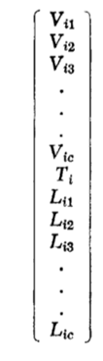
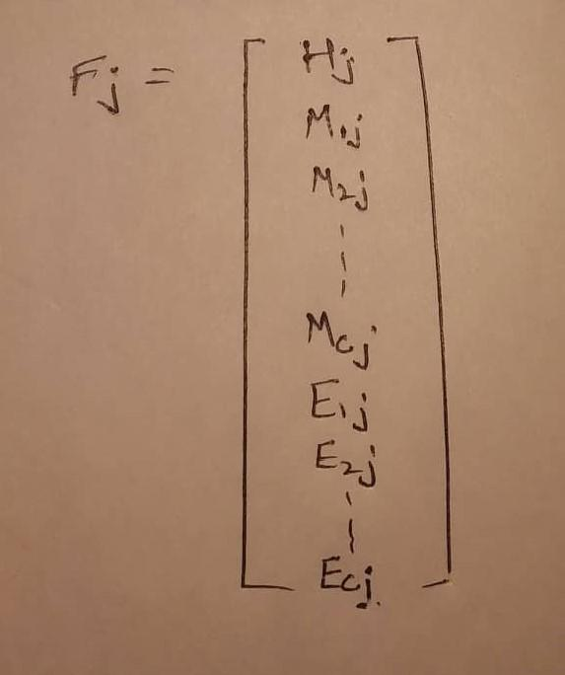

ALGORITHM
Initialization of Variables (Tij, vij, lij in a vector Xi ) :-
i
Calculated the Mij, Eij, Hi and formed a vector Fi :-

Slide 7
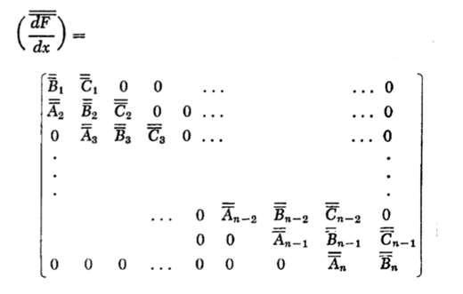
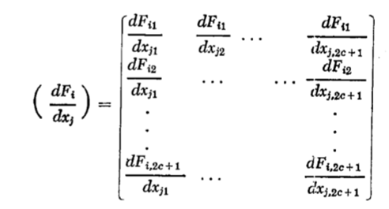
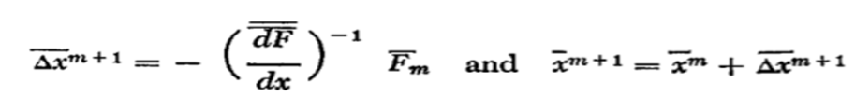
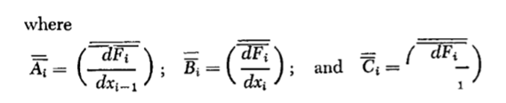
ALGORITHM
Evaluation of new guess using Jacobian Formula and Newton-Raphson Method :-
Solving Using Thomas Algorithm :-

Slide 8
ALGORITHM
Functions:
hv function: To calculate the enthalpy at each stage for the vapor phase, along with vapor phase non-ideality (departure function using Redlich Kwong EOS)
hl function: To calculate the enthalpy at each stage for liquid phase
Hj function: To calculate enthalpy equation for all the stages
Mij function: To calculate material balance equations for all components and stages
Eij function: To calculate equilibrium equations for all components and stages
StageH function: To calculate enthalpy equation at a given stage, used for evaluating partial derivatives
StageM function: To calculate material balance equations for all components at a given stage
StageE function: To calculate equilibrium equations for all components at a given stage
ABC function: To find Aj, Bj, Cj matrices for a given stage. Derivatives are calculated using Central Difference.
Plotting function: To plot the both my temperature vs stage plot and composition vs stage plot.

Slide 9
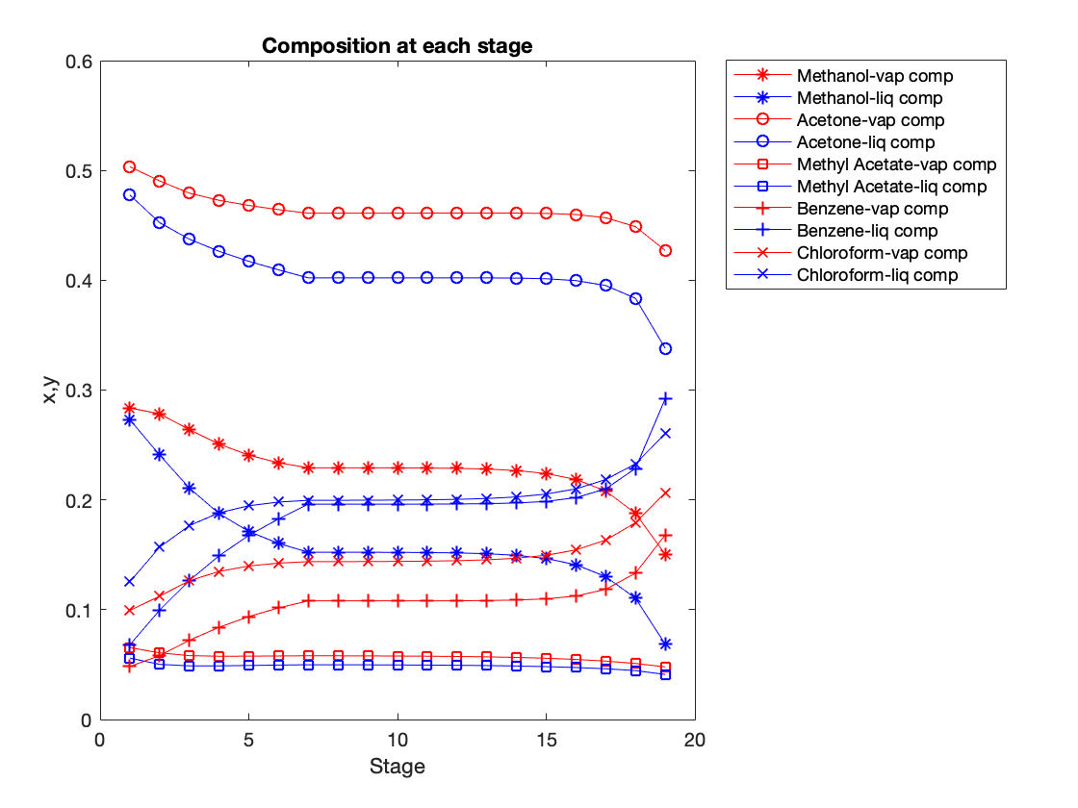
RESULTS - 1
Results obtained from Matlab:
The tau(𝝉) after 10 iterations = 4.5e-19
The epsilon(𝟄) after 10 iterations = 2.7e-22
The composition vs stage and temperature vs stage plots obtained are:

Slide 10
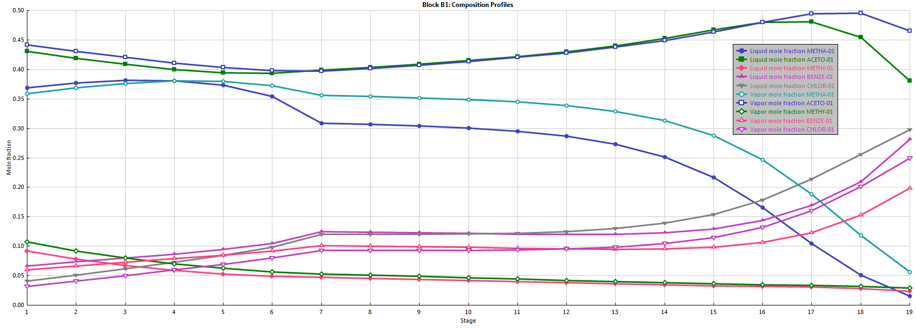
RESULTS - 2
Results Obtained in ASPEN:
The composition vs stage plots obtained is as follows:

Slide 11
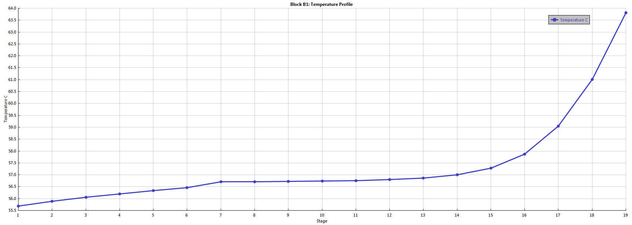
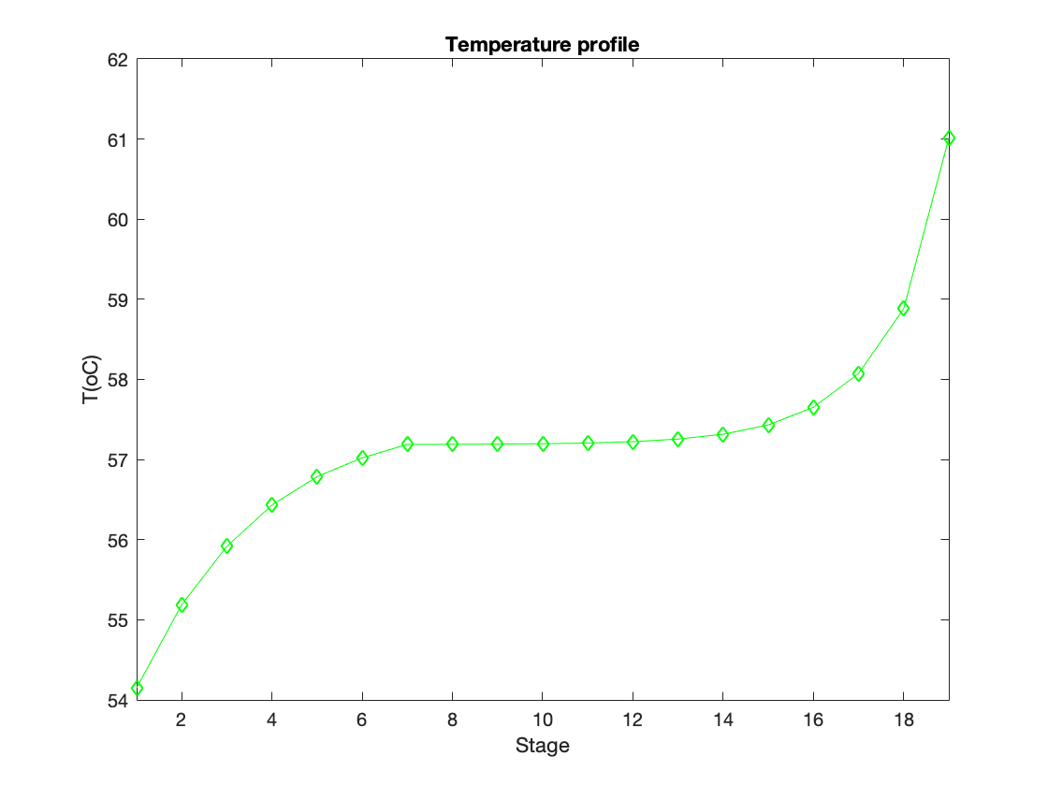
RESULTS - 3
Temperature profiles results obtained from Matlab and Aspen:
In Aspen: In Matlab:

Slide 12
comp/stage | 1 | 2 | 3 | 4 | 5 | 6 | 7 | 8 | 9 | 10 | 11 | 12 | 13 | 14 | 15 | 16 | 17 | 18 | 19
Methanol | 9.84 | 19.31 | 18.18 | 17.14 | 16.37 | 15.83 | 15.48 | 15.47 | 15.47 | 15.46 | 15.45 | 15.43 | 15.38 | 15.28 | 15.08 | 14.68 | 13.90 | 12.41 | 9.76
Acetate | 17.46 | 34.04 | 33.00 | 32.32 | 31.83 | 31.44 | 31.14 | 31.11 | 31.11 | 31.11 | 31.11 | 31.11 | 31.10 | 31.08 | 31.02 | 30.87 | 30.52 | 29.67 | 27.70
Methyl acetate | 2.27 | 4.21 | 4.00 | 3.94 | 3.92 | 3.92 | 3.92 | 3.91 | 3.91 | 3.90 | 3.89 | 3.87 | 3.85 | 3.81 | 3.75 | 3.67 | 3.55 | 3.37 | 3.11
Benzene | 1.67 | 4.03 | 4.97 | 5.74 | 6.37 | 6.88 | 7.30 | 7.29 | 7.29 | 7.29 | 7.29 | 7.30 | 7.31 | 7.33 | 7.39 | 7.55 | 7.92 | 8.81 | 10.90
Chloroform | 3.44 | 7.80 | 8.70 | 9.22 | 9.50 | 9.65 | 9.71 | 9.70 | 9.71 | 9.71 | 9.73 | 9.76 | 9.81 | 9.90 | 10.07 | 10.37 | 10.91 | 11.85 | 13.39
Above table is of vapor phase flow rates and following table is of liquid phase flow rates for each component at various stages:
comp/stage | 1 | 2 | 3 | 4 | 5 | 6 | 7 | 8 | 9 | 10 | 11 | 12 | 13 | 14 | 15 | 16 | 17 | 18 | 19
Methanol | 8.57 | 7.43 | 6.40 | 5.62 | 5.09 | 4.74 | 19.72 | 19.72 | 19.72 | 19.71 | 19.68 | 19.64 | 19.54 | 19.33 | 18.93 | 18.15 | 16.67 | 14.01 | 4.26
Acetate | 14.99 | 13.96 | 13.28 | 12.79 | 12.40 | 12.10 | 52.07 | 52.07 | 52.07 | 52.07 | 52.07 | 52.06 | 52.04 | 51.98 | 51.83 | 51.47 | 50.63 | 48.66 | 20.96
Methyl acetate | 1.76 | 1.55 | 1.48 | 1.47 | 1.46 | 1.46 | 6.46 | 6.45 | 6.44 | 6.43 | 6.42 | 6.39 | 6.35 | 6.30 | 6.22 | 6.10 | 5.92 | 5.65 | 2.54
Benzene | 2.13 | 3.07 | 3.84 | 4.47 | 4.99 | 5.40 | 25.39 | 25.39 | 25.39 | 25.39 | 25.40 | 25.41 | 25.43 | 25.50 | 25.65 | 26.02 | 26.91 | 29.00 | 18.10
Chloroform | 3.94 | 4.84 | 5.36 | 5.64 | 5.79 | 5.85 | 25.84 | 25.85 | 25.86 | 25.87 | 25.90 | 25.95 | 26.04 | 26.21 | 26.51 | 27.05 | 27.99 | 29.53 | 16.14

Slide 13
References:
For departure functions:Separation Process Principles Book by Ernest J. Henley and J. D Seader.
For RK equation of states, fugacity coefficients: Engineering and Chemical Thermodynamics Book by Milo D. Koretsky.
For Algorithm: Multicomponent Separation CaIcuIations by Linearization Book by Leonard M. Napthali and Donald P. Sandholm.

Slide 14
INDIVIDUAL CONTRIBUTION
ISHIKA SINGH: Base matlab code, debugging, presentation.
SIRJAN JAIN: Aspen, presentation, debugging.
MONAL GOEL: Degree of freedom analysis, presentation, debugging.
SHIVAM BARODIYA: Degree of freedom analysis, presentation.
KRISHAN KUMAR TETARWAL: Debugging, presentation.
VARANASHI NITESH : Aspen, debugging, presentation.
NAMAN SWARNKAR: Vapor phase departure function,Presentation.

Slide 15
Thank You

